Slide 1


Swiggy Restaurant Analysis
(Bangalore)
Presented By
Sawrav Yadav
Vishal Chauhan
Kaustubh Chitte
Pandala Shiva

Slide 2
Project Inroduction
Swiggy, a leading food delivery company in India, has analyzed data on restaurant orders and customer preferences in Bangalore. The data shows a growing demand for vegetarian options, and there is an opportunity for restaurants to capitalize on this trend by implementing strategies to improve their vegetarian offerings.
Based on the analysis of Swiggy restaurant data in Bangalore, customers in the city prefer South Indian cuisine the most, followed by Ice cream desserts, Chinnese, etc. The most expensive and cheapest restaurant on the basis of cuisines. And other various insights.

Slide 3
Data Extraction: We leveraged Python, Beautiful Soup, and Selenium to scrape
Data stored as CSV: After extraction and processing, we saved the cleaned and structured data as CSV files for further analysis.
Visualization: Power BI was used to visualize trends, patterns, and key insights derived from the restaurant data.
Project steps
Insights Generation: Through in-depth data analysis and visualization in Power BI, we generated actionable insights.
Data Cleaning:
Cleaned, validated, and formatted the data, handling missing values.

Slide 4
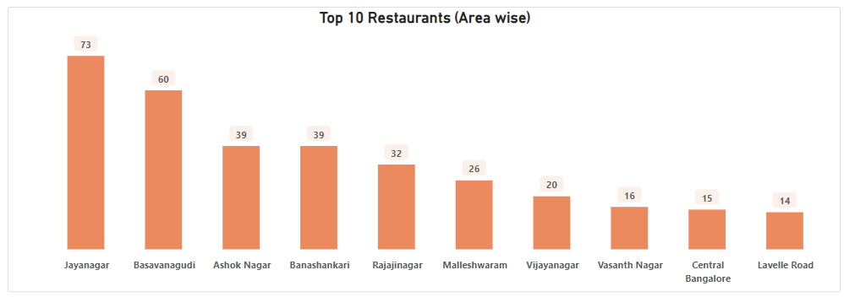
Top 10 LOCATION in Bangalore (RESTAURANTS COUNT)
Jayanagar Stands on Top with 73 Restaurants

Slide 5
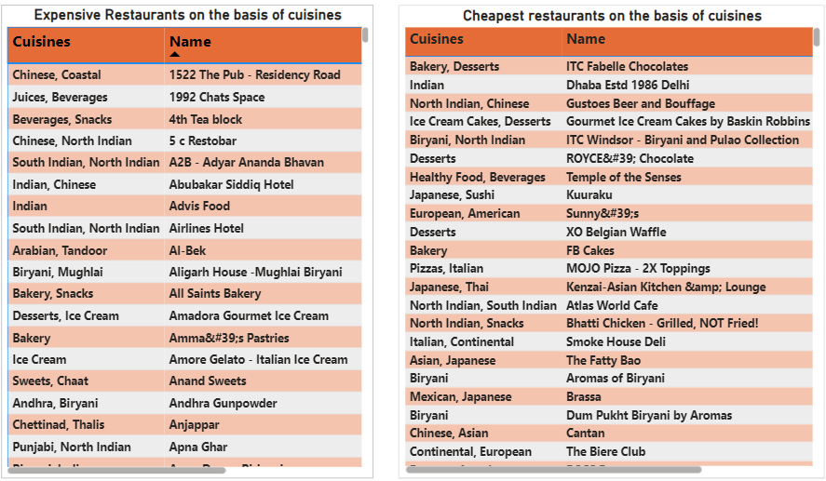
Most Expensive & Most Cheapest Restaurants in Bangalore which are extracted based on their Cuisine prices

Slide 6
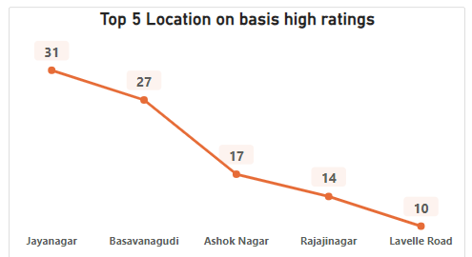
Top 5 Locations having most Ratings of the Restaurants

Slide 7
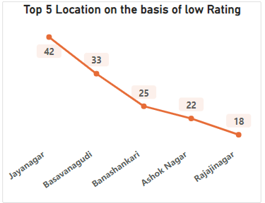
Top Locations having least Ratings of the Restaurants

Slide 8
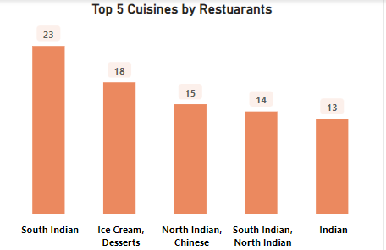
Top 5 Cuisines AVAILABLE IN THE RESTUARANTS

Slide 9
CHALLENGES
Scrapping the data from the web source is one of most challenging task for us.
We encountered issues with web source blocking due to the absence of delays in our code on multiple occasions.

Slide 10
Learning outcomes
Web scrapping.
New python libraries like selenium and beautiful soup for data extraction.
Basic knowledge of html tag.
Time management.
Team work and coordination.

Slide 11
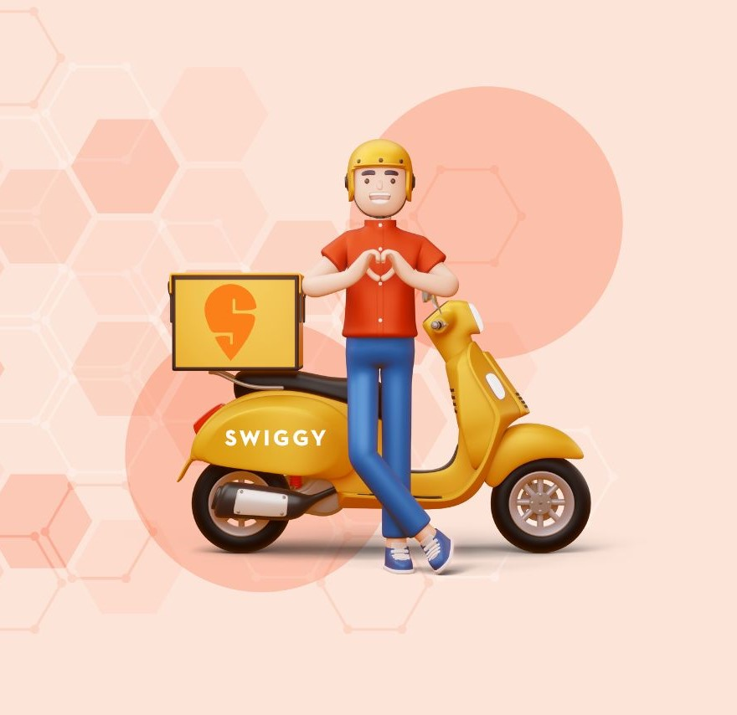
Thank
YOU

